Slide 1
Recognising, Celebrating and Defining Innovation: The Telematics Charitable Trust’s Approach to Grant Allocation
Nicholas Reynolds
The University of Melbourne

Slide 2
The Telematics Trust
$3 Million Dollars in 1985 – now a corpus of $9.5m
Have funded more than $9m in grants over that period
The key objective of the Telematics Trust is to financially support innovative and educational information and communication technology initiatives within Victoria, for the social, economic and cultural wellbeing of Victorians.
Telematics is the delivery of information via a combination of computers and wireless technologies
http://www.telematics.org.au/

Slide 3
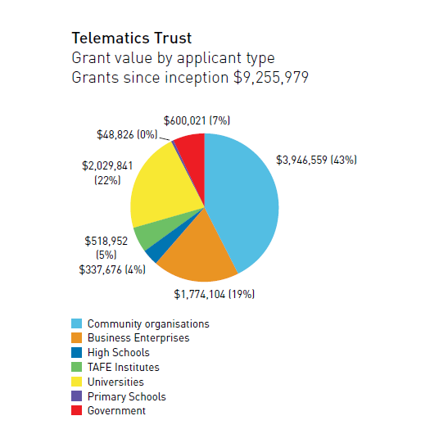

Slide 4
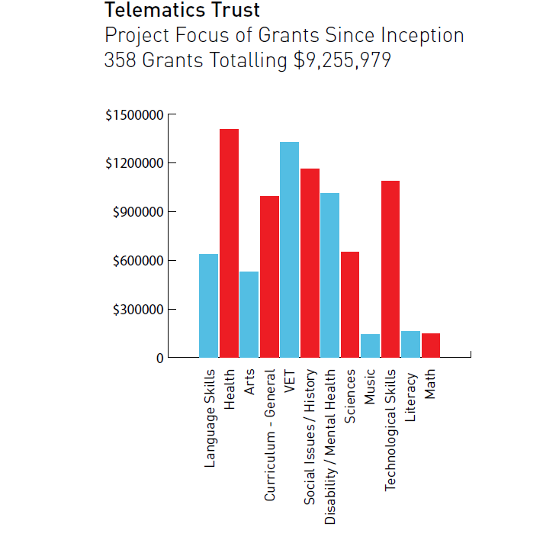

Slide 5
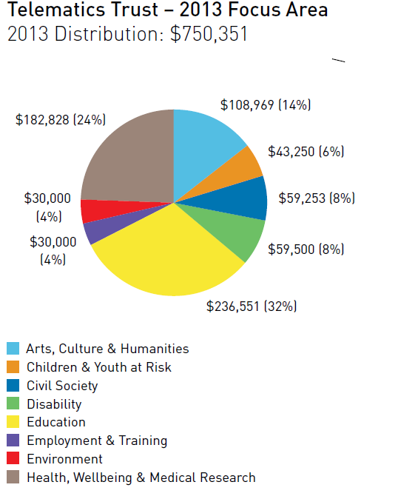

Slide 6
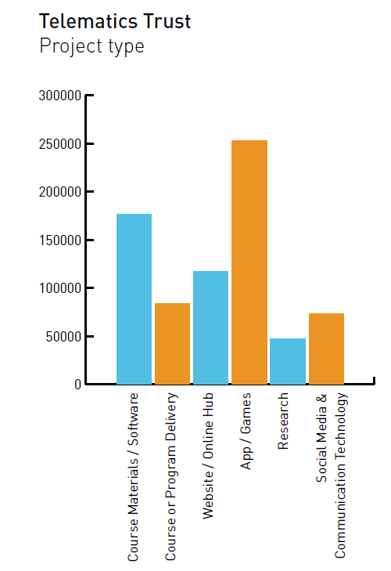

Slide 7
Some examples of innovation - technological
2003 – Development of Web 2.0 portals
2004 – CD materials and web development
2005 – CD ROM materials, web development and podcasts
2009 - Mobile phone technologies and interactive static displays started emerging
2011 – Apps and eLearning
How innovative are these projects?

Slide 8
Some examples of innovation – content and audience
2003:
A grant of $25,000 to develop a self directed interactive web based education package to support infection control practitioners, particularly those based in rural Victoria, in activities to reduce hospital acquired infections

Slide 9
Some examples of innovation – content and audience
2003:
A grant of $22,800 in support of a customisable web environment (portal) for children with chronic illness. The web environment affords Victorian students in hospital an opportunity to build and customize a personal web site.
  Accessible from the hospital bed, the home and school of origin and will allow students to configure and display their own content.
  chat rooms, email, videoconferencing, personal pictures, a web diary (blog) as well as a wide variety of online content.
Young people in hospital are significantly disempowered in most aspects of their treatment and disconnected from school and friends

Slide 10
Some examples of innovation – content and audience
2009
Watch This! will provide downloadable video resources for ESL/EFL learners for mobile devices such as mobile phones and mp3/4 players/ iPods. The content will sit on two websites:
  As a new content stream on www.virtualilic.com which will host the videos and accompanying activities
  A mobile website for direct download of the videos onto mobile phones

Slide 11
Some examples of innovation – content and audience
2011
This project will develop a social media platform to provide customised information technology tools to enhance the caregiver’s quality of life, going beyond the standard medical locus of information on diagnosis, prognosis and treatment options to include lifestyle and social interaction domains.
The tools will be focused on providing the caregiver with timely information from reputable sources and access to the relevant community in a simple and private manner, uniquely and deliberately targeted towards the needs of the caregiver

Slide 12
The list goes on and on…
Mobile support for telephone technicians to address bush fire risks when in the field
Online training and support for unemployed and disadvantaged women
An app that maps and provides information about a historically significant ship wreck
Who are these people?
Collaborations between industry and education
Volunteers, community interest groups
Individuals, start ups, charities, associations

Slide 13
Time to Define
2010 a significant increase in applications
How do we differentiate these applicants?
How do we define what we see is innovative practice within the terms of the Trust?
What does innovation look like and does that definition change dependent on context and applicant?

Slide 14
Possible solutions
Increase the rigidity and specificity of the application process:
  Tell the community what we mean by ‘new and innovative’
Be as flexible as possible with very little specification:
  Interpret the Trust Deed on a case-by-case basis

Slide 15
Considerations
Our applicants:
Wide range of organisations and individuals
Wide range of needs and competence
Wide range of audiences and clients
Technological solutions must suit the capacity, knowledge, budget, and purpose

Slide 16
Considerations
Is there a shared understanding of the meaning of ‘innovation’?
Should ‘innovation’ be restricted by a specific and rigid definition or set of criteria?
  Can it be?
What do we want to achieve as a Charitable Trust?

Slide 17
Outcomes
That flexibility is an essential characteristic to enable successful interpretation of innovative ideas
That innovation must be judged contextually
  It is just as innovative to engage disadvantaged, unemployed people with low levels of education in online training as it is to provide 3D simulations for driver training to school students
That rigid judgements on ‘what is innovative’ can create an elite and exclusive set of successful applicants

Slide 18
Conclusion
The Trustees agreed that while their processes must be transparent, a rigid definition of what innovation looks like is counterproductive.
Focusing on the technological aspects when considering innovation is only part of the story
Understanding the context of the innovative practice and celebrating the applicant’s own understanding of their audience and the ways in which technology can support them ‘in innovative ways’ actually leads to more innovation.

Slide 19
Thank You

