Slide 1
Computer Science (CS) or Information and Communication Technologies (ICT): The curriculum needs both
IFIP Conference 2015
Don Passey
Vice-chair, IFIP TC3
Professor of Technology Enhanced Learning
Department of Educational Research
Lancaster University
Notes:
LANCASTER UNIVERSITY POWERPOINT TEMPLATES
These PowerPoint templates are for use by all University staff. Please see below for further information regarding the use of these templates. Should you have any further queries, please contact the marketing team via webmaster@lancaster.ac.uk
Template slide 3: Insert a new slide
If you need to insert a new slide, from the ‘home’ toolbar, click on ‘new slide’ and select from the templates the style you require from the dropdown box.
Template slide 4: Typing new text and copying text from another document
New text should be typed over the text in the appropriate template. Copy and pasting text from another document will result in changing the style of the typography and layout. This is unavoidable as it is part of the Microsoft software. We appreciate that in sometimes you will need to copy text from another document into this template. Once you have pasted the existing text into the template, you will need to change the formatting so that they typefaces, sizes, colour, line spacing and alignment are consistent with the rest of the template.
Template slide 5: Inserting images
There are three choices of templates with images already inserted. Please use the template with the relevant image size and positioning. To insert an image, please go to ‘insert’ then ‘picture’ and find your image, highlight it and ‘insert’. Resize the image and position as per the example template.
Template slide 6: Text boxes
If a text box is deleted, either insert a new slide (using the appropriate template) or go to another slide and copy a text box. To select a text box for copying, please click on the outer edge of the text box so that the line goes solid (not dashed). Right click your mouse and select ‘copy’, then go back and ‘paste’ it into the slide where the text box is missing which should paste into the correct position on the slide.
Template slide 7: Other information
Typefaces, sizes and colours All copy is Calibri.
Slide title copy throughout:
Size: 36 point
Colour Lancaster University red: (RGB) R: 181 G: 18 B: 27 (recent colours on PowerPoint) Small copy on first and last slide: Size: 16 point Colour grey: (RGB) R: 102 G: 102 B: 102 (recent colours on PowerPoint)
Sub-headings: Size: 24 point – italics Colour grey: (RGB) R: 102 G: 102 B: 102 (recent colours on PowerPoint)
Bullets copy and body copy: Size: 24 point (see below for a further option) Colour grey: (RGB) R: 102 G: 102 B: 102 (recent colours on PowerPoint)
It isn’t advisable to have too much text on a slide, however on rare occasions it may be necessary, therefore there is a slide using 20 point bullet pointed text.
Line spacing and alignment
Single line spacing (apart from the main headings which is ‘exactly 35 point’)
All text is aligned left
Slide title options
There are two options for titles on the slides – one line or two lines for longer titles. Ideally, the one line title should be used, however on rare occasions a two line title maybe needed.

Slide 2
Summary
Background
Arguments for a Computer Science (CS) curriculum
Arguments for an Information and Communications Technology (ICT) curriculum
National policies and directions
School practices and needs
Questions to shape the future

Slide 3
Background - history
In 1962, Purdue and Stanford Universities established perhaps the first departments of computer science
The first PhD in computer science was awarded in 1965 by the University of Pennsylvania
A robotic hand was developed in the same year at the University of Belgrade
Since the 1980s, there have been concerns that computing and technologies should play a major role in school curricula and practice
The Department of Trade and Industry supported the first microcomputers in schools in the UK

Slide 4
Arguments for a CS curriculum
economic argument - education should support learners in a curriculum most likely to support a future economy, where young people meet the needs of current and future jobs and their skill requirements
organisational argument - industries and institutions are increasingly engaging and employing learning technologists to support their own individual local needs
community argument - computing facilities are increasingly being and will increasingly be used for social purposes but also by ‘communities’, including social communities
educational argument - with new developments and new areas being opened up, education should appropriately support and fulfil these needs
learning argument – computer science activities demand creativity and problem-solving approaches
learner argument - learners should be enabled to engage not only in what are considered to be generic areas of future need (such as numeracy and literacy), but also in areas that interest them

Slide 5
Arguments for an ICT curriculum
economic argument - education should support learners in a curriculum most likely to support a future economy, where young people meet the needs of current and future jobs and their skill requirements
organisational argument - industries and institutions are increasingly engaging and employing learning technologists to support their own individual local needs
community argument - computing facilities are increasingly being and will increasingly be used for social purposes but also by ‘communities’, including social communities
educational argument - with new developments and new areas being opened up, education should appropriately support and fulfil these needs
learning argument - current and new facilities require users to have technical, operational and application skills and competencies if they are to use and apply such facilities to support themselves and others
learner argument - learners should be enabled to engage not only in what are considered to be generic areas of future need (such as numeracy and literacy), but also in areas that interest them
research argument?

Slide 6
National policies and directions

Slide 7
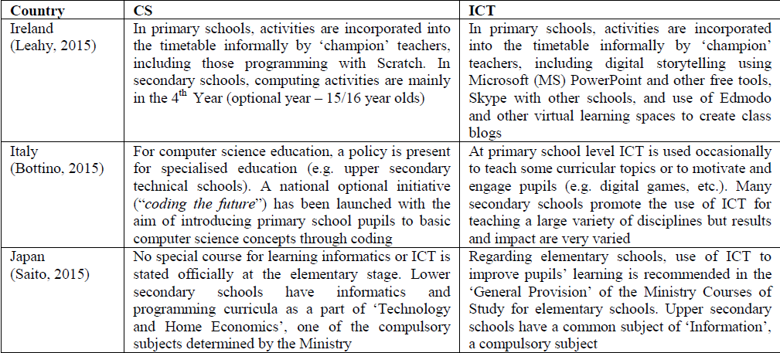
National policies and directions

Slide 8
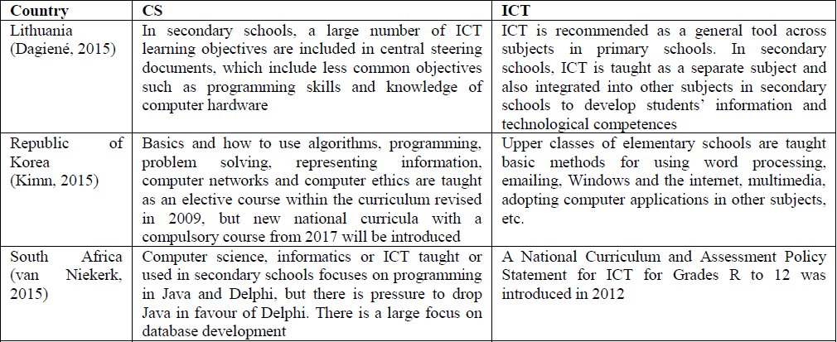
National policies and directions

Slide 9
Curriculum change – future needs
A high-quality computing education equips pupils to use computational thinking and creativity to understand and change the world
Computing has deep links with mathematics, science, and design and technology, and provides insights into both natural and artificial systems
The core of computing is computer science, in which pupils are taught the principles of information and computation, how digital systems work, and how to put this knowledge to use through programming (DFE, 2013: n.p.)
England is not alone in curriculum changes of this type

Slide 10
School practices and needs
Computing can be applied in different situations
Formal – in classrooms, focusing perhaps on the learning of the individual
Informal – in home and community, focusing more on application, identifying practices and needs
Non-formal –in groups or clubs, supported, but focusing on, working together, on tasks or projects
Example image

Slide 11
School practices and needs
Example image
Formal – class work and ‘knowledge’
Scratch or Game Maker
Informal – engaging with others
Raspberry Pi, Lego Robotics or Micro Bits
Non-formal – projects or interest-groups
Video games such as Little Big Planet 2

Slide 12
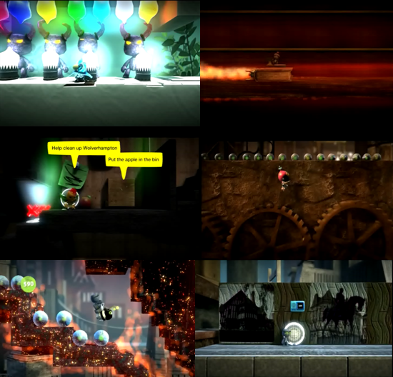
School practices and needs

Slide 13
Questions to shape the future
The economic argument. Does a school have access to knowledge about the ways that CS and ICT are being used and developed in employment situations, and what future needs might arise?
The organisational argument. Does a school understand how CS, computing and ICT skills are deployed and managed in organisations, and do they have facilities to undertake team work or group work activities of this form?
The community argument. Can a school manage and support activities that are undertaken in non-formal or informal situations, linking with community or organisations to engage with their needs through problem solving and creative solutions?

Slide 14
Questions to shape the future
The educational argument. Does a school have the flexibility to support a curriculum that can provide activities for all learners across certain age ranges, but offer elected courses for those beyond those age ranges?
The learning argument. Does a school have the facilities to enable teachers to access and use technologies to support both an ICT focus and a CS focus?
The learner argument. Does a school enable its learners to engage at times when their interest might be stimulated in CS or computing or ICT?
Check the studies in the Doctoral Consortium!

Slide 15
My thanks
Jari Koivisto for the opportunity to develop and present this paper, from his interest in, feedback on and translation of an original paper from English to Finnish
The IFIP TC3 national representatives who submitted national education and technology reports that provided an important international perspective for this paper
Claire Johnson, whose PhD thesis provided invaluable, further insight into this topic

Slide 16
References
ACARA, 2013. Draft Australian Curriculum: Technologies. Accessed 5 January 2015 at: http://consultation.australiancurriculum.edu.au/Static/docs/Technologies/Draft%20Australian%20Curriculum%20Technologies%20-%20February%202013.pdf
Bureau of Labor Statistics, 2012. Economic News Release, Employment Projections: 2010-2020 Summary. United States Department of Labor, Washington, DC
DFE, 2013. Statutory guidance – National curriculum in England: computing programmes of study. https://www.gov.uk/government/publications/national-curriculum-in-england-computing-programmes-of-study/national-curriculum-in-england-computing-programmes-of-study
Johnson, C., 2014. ‘I liked it but … it made you think too much’: A case study of computer game authoring in the Key Stage 3 ICT curriculum. PhD thesis, University of East Anglia, Norwich, UK
Livingstone, I. and Hope, A., 2011. Next Gen. Transforming the UK into the world’s leading talent hub for the video games and visual effects industries: A Review. Nesta, London
Passey, D., 2012. Independent evaluation of the Little Big Planet 2 project in Wolverhampton’s Local Education Partnership schools: Outcomes and impacts – Final report. Lancaster University, Lancaster
Passey, D. (2013). Inclusive technology enhanced learning: Overcoming Cognitive, Physical, Emotional and Geographic Challenges. Routledge: New York, NY
The Tech Partnership, 2015. Tech Partnership Progress update April 2014 – March 2015. The Tech Partnership, London

Slide 17
Contact
d.passey@lancaster.ac.uk

