Slide 1

Niki Davis & Julie Mackey
University of Canterbury e-Learning Lab
Aotearoa New Zealand
Co-evolutionary Perspectives on Innovation with Digital Technologies in Education
Notes:
Based on our Teaching and Learning Research Initiative (TLRI) project called “Extending innovative leadership to enable e-learning for better student outcomes in primary schools” . We began with a pilot in mid 2012, and the project was funded for 2013-2014.
Niki Davis’ arena of change with digital technologies in education provides this co-evolutionary framework to enable practitioners and researchers to conceptualise the complex chaos that is part of schooling in the 21st century with a teacher and her networked class at the centre of the interacting ecologies. Although the teacher is the central keystone species in her class, research into school leadership is identifying the importance of that role in leading and managing change.
The challenge of researching such complex and chaotic systems can be approached by case study, informed by eco-cultural theories. Stakeholders and participants can be recruited to assist in data gathering in ways that improve equity and interpretation (Davis, Mackey & Stuart, 2015). This will be illustrated with research of the case study of the leadership of a future focussed school in New Zealand, undertaken in collaboration with the principal (Stuart) and four additional primary school principals. In common with action research, this case study naturally begins its dissemination near the start of the research as the principals reflect on leadership and interpret it into action in their own schools. The research was strongly informed by Levin and Schrum’s (2013) case studies of exemplary schools in the USA.

Slide 2
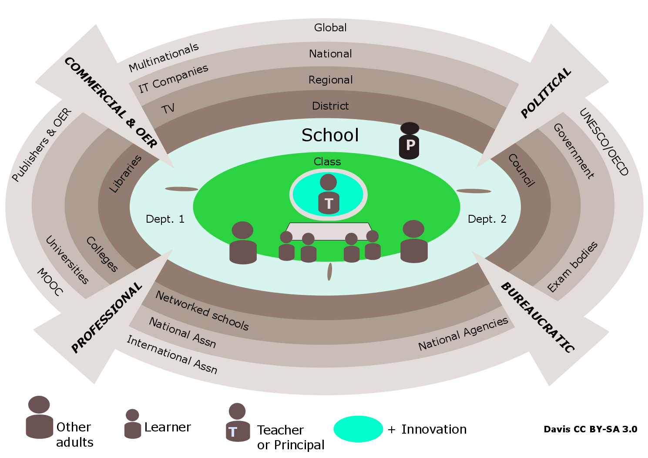

Davis’ Arena of Change with digital technologies in education

Slide 3


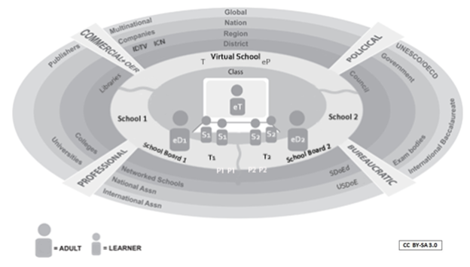










Trends

Slide 4
New Zealand national project
How can key messages from successful technology leadership in schools ...
Contemporary Learning
inform future focused decision making and leadership?
Notes:
Our project was set in the context of the UFB roll out across NZ - recognising the increasing potential of technology to strengthen networks between schools and parents/whānau and the wider community, to address inequities in educational outcomes; and to support 21st century learning and learners.
While the project was focused on strategies for leading change with digital technology there is relevance for the challenges facing Christchurch schools as they redesign teaching spaces and approaches.

Slide 5

An example of researching innovation &
Building leadership capacity in schools
Leading takes courage
Sharing your leadership takes more courage
Sharing research of this even more courage
magnifying glass
fishbowls
Notes:
At the heart of our project was a highly successful principal, Carolyn Stuart, who had engaged with technology courageously, and more courageously was willing to put herself and her school under scrutiny so that we could identify the strategies and approaches that had contributed to successful technology integration.
With Carolyn’s help we identified some leading principals to help us uncover insights and dig deep into the strategies used at TIS.

Slide 6
Case study of innovative school leadership
- collaborative research with school & 4 other principals
TIS
school
leaders
Interviews and focus groups
School and classroom observations
Artefacts and virtual evidence
Project team meetings
Project team reflections
Blended Research Environment
Notes:
We used a range of approaches to explore the leadership strategies that Carolyn and her team employed to lead digital change: our data collection included research team meetings; interviews and focus groups; school and classroom observations; collection of artefacts and virtual evidence from websites; and project team reflections from an online space in MyPortfolio.

Slide 7



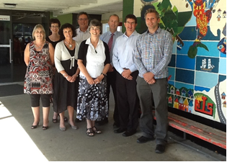
Notes:
Our team included Carolyn Stuart principal at Tawa Intermediate (who joined Network for Learning but continued in the project); and a group of highly competent and experienced principals – who wanted to develop their technology leadership and could ask the hard questions:
Brendon Henderson and DP Keith Rickard, Tawa Intemediate
Anne Lye, Churton Park School
Trevor Jeffires, Levin Intermediate
Peter Simpson, Belfast Primary

Slide 8
TIS spark to ignite
Christchurch school leaders
Key strategies all needed to work together
Culture first
Adapted from Schrum, L. & Levin, B. (2012). Evidence-based strategies for leading 21st century schools. Thousand Oaks, CA: Corwin.
Extending innovative leadership to enable e-learning for better student outcomes in primary schools

Slide 9

Vision
Engage! Grow! Inspire!
At Tawa Intermediate our passion is to create a school that is relevant to the age in which we live. We believe in taking the best educational practices and blending them with the opportunities that digital technologies allow to create a 21st century learning environment that empowers our young people to succeed in their world.
.
Notes:
Vision highly visible across the school and its web site.
Followed cultural shift
Technology is not separate but part of the future focused approach – 2 years.
Developed alongside the new Inquiry baced
Student learning at the centre
Charter 2013 – 2017
Mission Statement
A community of confident, connected, actively involved, lifelong learners.
Relevant to the age in which we live.

Slide 10
Relationships and culture first
Notes:
What did this leading principal do?
Relationships and culture first focus on trust in people and authentic relationships
E.g. Strategy
Dialogue convenants - trusting and respectful relationships
Honorouring alliegance to the practice, including celebrating the change
Leadership, teachers and students – 2 complementary covenants

Slide 11

Future focus - building staff capability
Notes:
Embedding technology in school processes and buildilng staff capability first.
Google Docs was one tool used within leadership team to build capacity
Adminstration and collaboration processes with staff
Once they felt comforatble staff started to lead at own pace
Informal and formal intentional and emergent
Less confident and capable immersed in supprtive culture

Slide 12


Teacher innovation through inquiry based
practice
Notes:
As teachers became more confident that they were trusted and supported then they proposed and developed strategies
And shared them with others, within and beyond sydicates
Innovated to make the most of existing and student resources

Slide 13
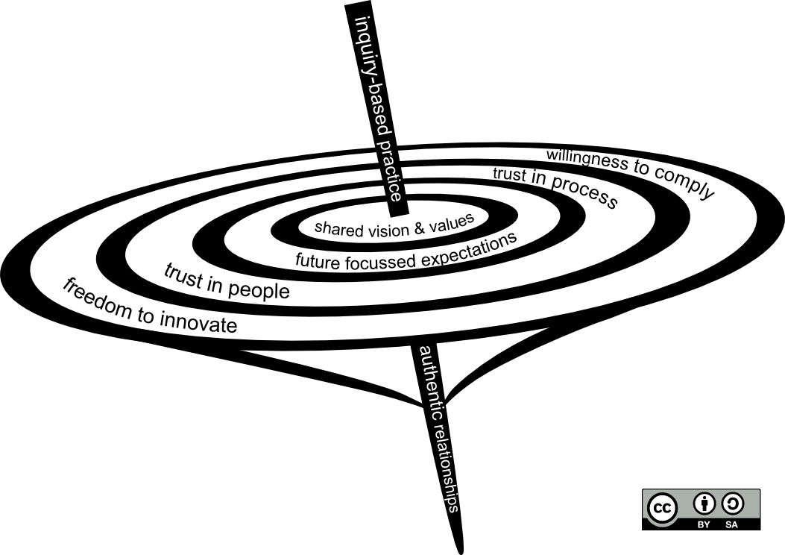
Notes:
We found the spinning top more useful as an analogy than the pie chart:
The faster it spins the less the boundaries can be seen between the different ‘keys’
It is not difficult to spin out and overbalance
Whole community authentic relationships are pivotal
Innovative practice evolved and compliance was easier as it was a community

Slide 14
Davis’ Arena of Change with digital technologies in education

Slide 15
This symposium’s questions are:
What does it mean to be innovative? How can we define and describe innovative digital pedagogies? How do other stakeholders perceive innovation in the classroom?
How can we judge what counts as innovative? What are the methodological challenges of addressing this in research contexts? How might these challenges be overcome?
How can we best support innovation and change? Which approaches might be most effective?

Slide 16
1. What does it mean to be innovative?
How can we define and describe innovative digital pedagogies?
How do other stakeholders perceive innovation in the classroom?
Co-evolving with digital technologies is ongoing; the arena can be a way to frame
The arena indicates many stakeholders who are also co-evolving (or blocking)

Slide 17
2. How can we judge what counts as innovative?
What are the methodological challenges of addressing this in research contexts?
How might these challenges be overcome?
Methodological challenges include studying chaotic change while addressing equity. Our methodology is embedded with the leaders we study.
This is also a means of addressing one or more challenges, which include leadership capacity

Slide 18
How can we best support innovation and change?
Which approaches might be most effective?
Take a look at the bigger picture, which is where the arena of change comes in, bringing together multiple perspectives
Include leaders of educational institutions, including ways to build their capacity to lead innovation
Build in strategies for dissemination and equity form the start

Slide 19
Acknowledgements
Carolyn Stuart, Researcher and Principal of Tawa Intermediate School until March 2013. Currently Education Sector Lead for Network for Learning
Research team and their schools, especially TIS and the current principal Brendon Henderson and deputy Keith Rickard. Also our critical friend Professor Lynne Schrumm.
Funding from the Teaching and Learning Research Initiative managed by NZCER
Further information see TLRI web site
Notes:
We would like to acknowledge the essential contributions of our research team including all of the principals and particularly Carolyn Stuart; Tawa Intermediate School staff who have hosted and accommodated us; our critical friends Professors Lynne Schrum and Bridget Somkeh; and the support of the TLRI research fund administered by NZCER.

