Slide 1
Promoting a New Culture of Learning with EDUsummIT and UNESCO
http://www.ifip2015.mii.vu.lt/
Niki Davis, University of Canterbury, New Zealand. TGW: Smart partnerships – organisational change
Mary Webb, Kings College, University of London, UK. TGW: Assessment as, for and of learning in the 21st century
Nick Reynolds, The University of Melbourne, Aus TGW: Creativity
David Gibson & Kwok Wing Lai, EDUsummit co-chairs

Slide 2
Overview
What is EDUsummIT; How did it originate
EDUsummIT 2015
Presentations of EDUsummIT working group outcomes and action plans
Discussion

Slide 3
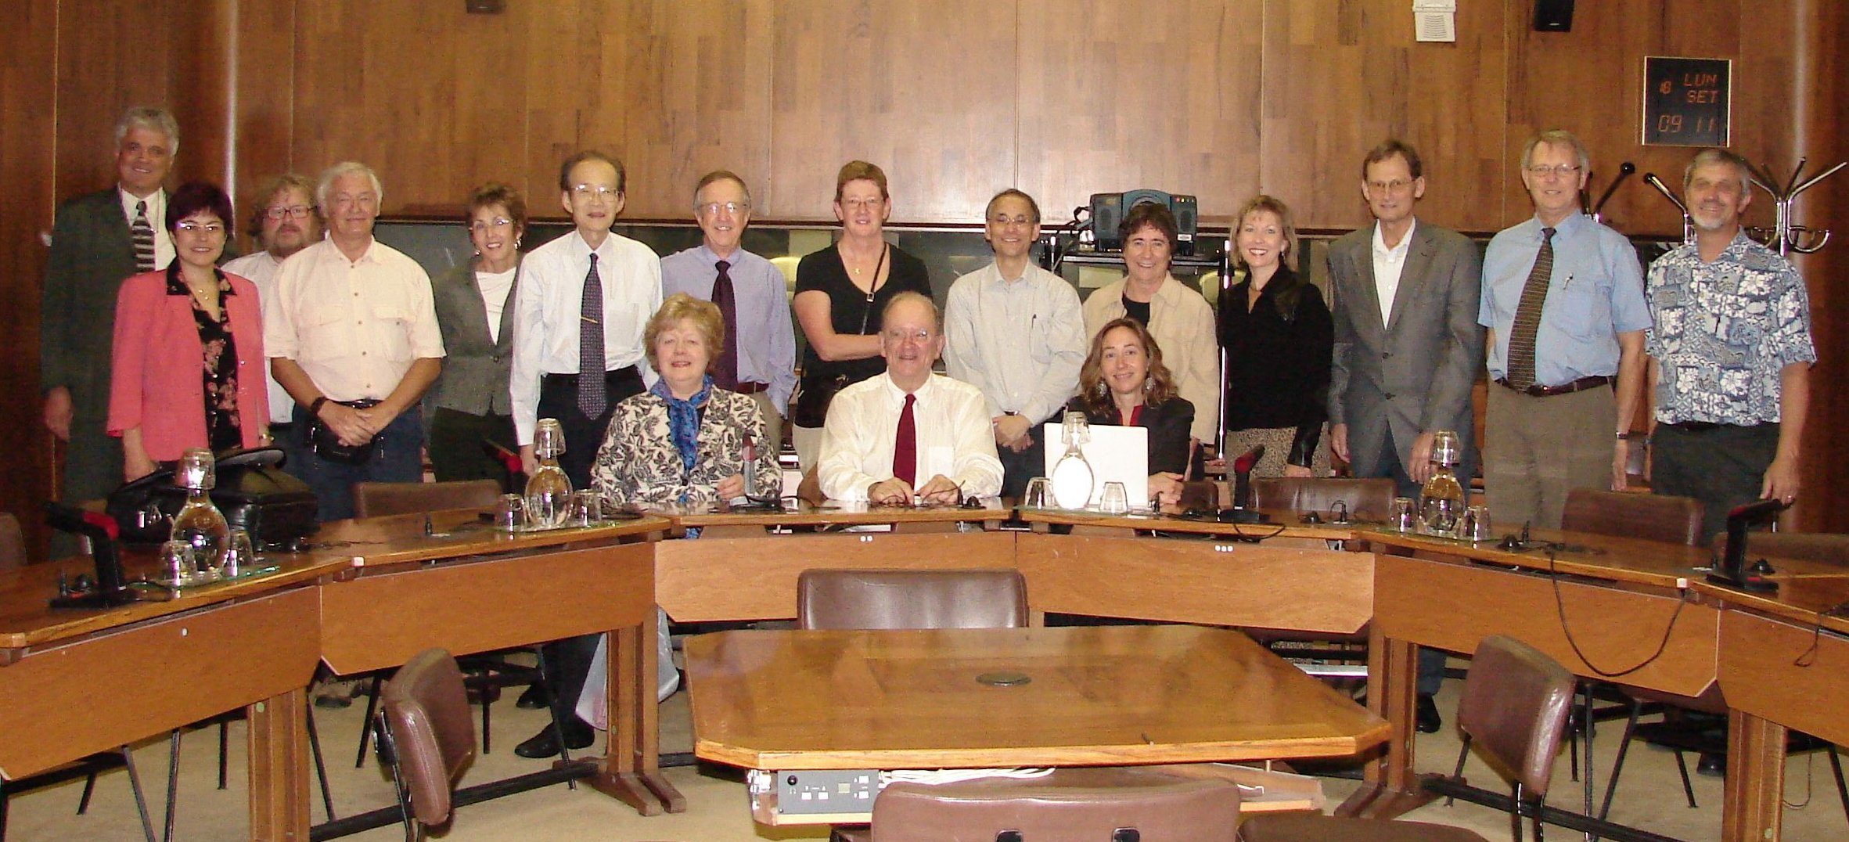
Start – UNESCO, Paris, 2006
Notes:
Joke Voogt & Gerald Knezek, led the charge

Slide 4
What is EDUsummIT
EduSummIT is a global community of policy-makers, researchers, and educators working together to move education into the digital age. The EDUsummIT community recognizes the need to respond to the challenges of a world transformed by globalization and economic transformation, caused to a large degree by the development of digital networking technologies.
The EDUsummIT seeks to engage educational leaders from across the world in conversations framed around issues and challenges facing education today and through that dialog, develop action items that are based on research evidence.

Slide 5
Leading questions of the Handbook
Aim
Synthesis of research on ICT in education from a broad international perspective
Target group
Researchers, policy makers and professionals
Contributors (not counting advisers)
11 sections, 76 chapters, 136 authors

Slide 6
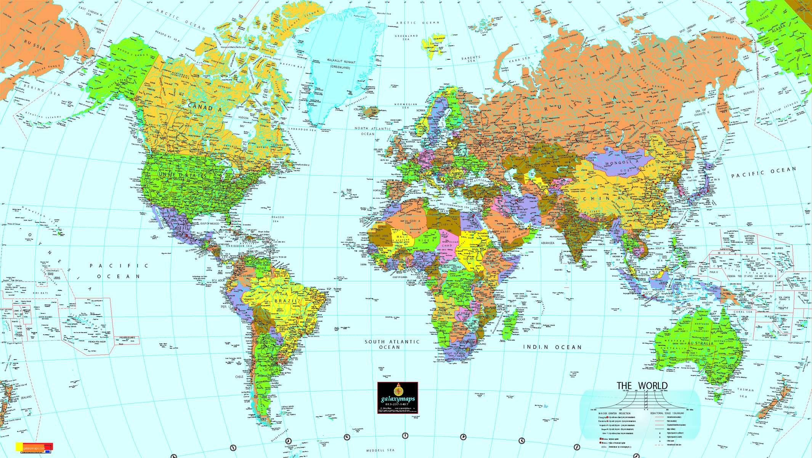


Slide 7
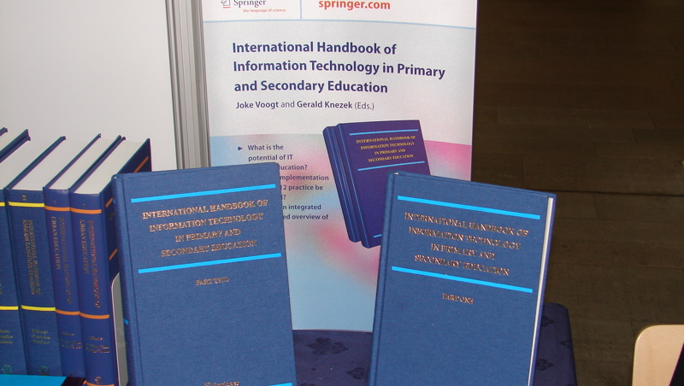
International Handbook of Information Technology in Primary & Secondary Education
International Handbook of Information Technology in Primary & Secondary Education
Voogt & Knezek, 2008
7
Notes:
7

Slide 8
What research has demonstrated
ICT can enhance teaching and learning
Under which conditions ICT works (at system, school and teacher level)
But
ICT scarcely finds its way in teaching and learning practice

Slide 9


EDUsummIT 2009 The Hague:
Closing gaps between research policy and practice
Notes:
9

Slide 10

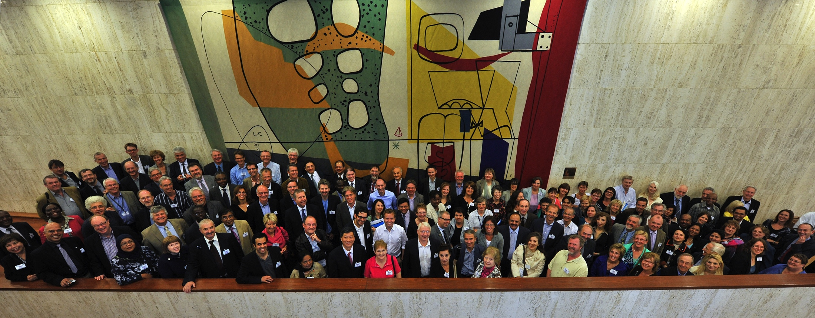
^{EDUsummIT 2011, UNESCO Paris}
Building a Global Community of Policy-makers, Researchers and Teachers
to Move Education Systems into the Digital Age

Slide 11

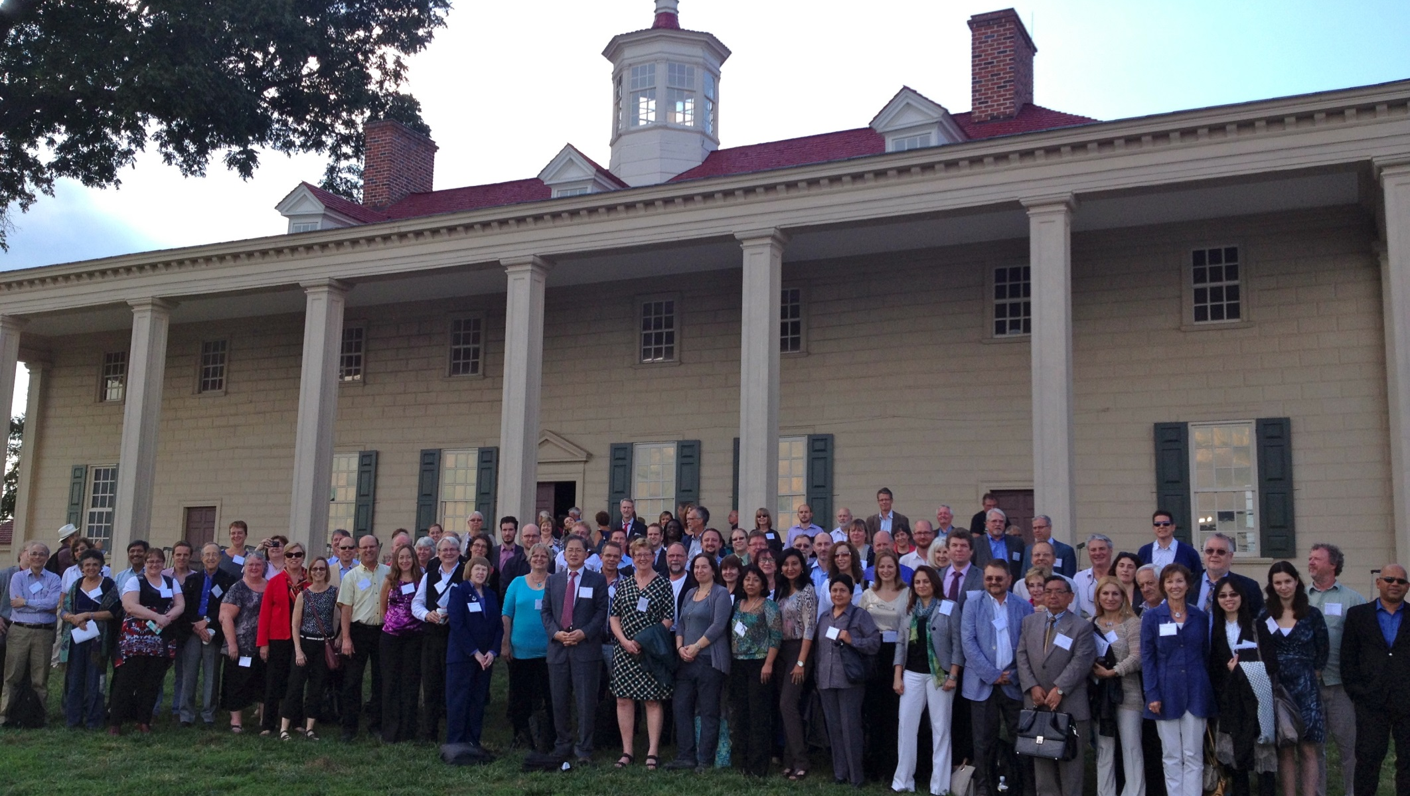
Research-informed Strategies to address Educational Challenges in a Digitally Networked World

Slide 12
EDUsummIT 2013 Working Groups
Towards new systems for schooling in the digital age
Advancing mobile learning in formal and informal settings
Professional development for policy-makers, school leaders & teachers
Digital equity and intercultural education
Assessment as, for and of 21st century learning
Advancing computational thinking in 21st century learning
Observatories for researching the impact of IT in education
Digital citizenship and literacies around the world

Slide 13
Action Agenda –issues across all 8 groups
Identifying what works and what does not work
Locating best practices to inspire research and practice
Bridging formal and informal learning
Developing new forms of technology-based assessments
Encouraging collaboration within and between constituencies
Using previously successful collaborative research strategies to foster the integration of IT into teaching and research
Making research accessible to a broad range of constituencies

Slide 14
Outputs & Impact
Pre- and post summit papers
in Denmark several new research initiatives were initiated
Conference papers
“In our country a great emphasis has been given to ICT in education and an effort has been taken to prepare a Master Plan on ICT in education” (Bangladesh, policy sector)
Special issues
www.edusummit.nl
www.curtin.edusummit.au
Scholarly papers
‘Guided US 2010 National Educational Technology Plan’
Call to Action

Slide 15
EDUsummIT2015
In the Asian Pacific Region chaired by David Gibson (Australia) & Kwok Wing Lai (Aotearoa New Zealand)
In close collaboration with UNESCO Bangkok office
Meet in Bangkok 14-15th September 2015
Already working online on discussion papers that lead into a 2 page policy briefs for APEC Ministers
UNESCO UIS papers already feeding in as well

Slide 16
Working groups present @ IFIP2015
TWG1: Smart partnerships
TWG5: Assessment as, for and of learning in the 21st century?
TWG6: Creativity in a technology enhanced curriculum
TWG9: Curriculum - advancing understanding of the roles of CS/informatics in the curriculum
Web site and Google Docs:
http://www.curtin.edu.au/edusummit/

Slide 17

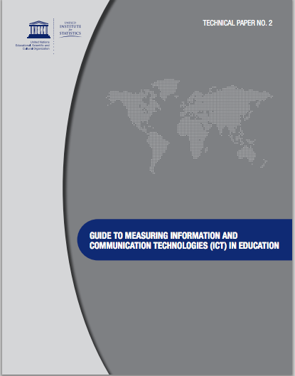
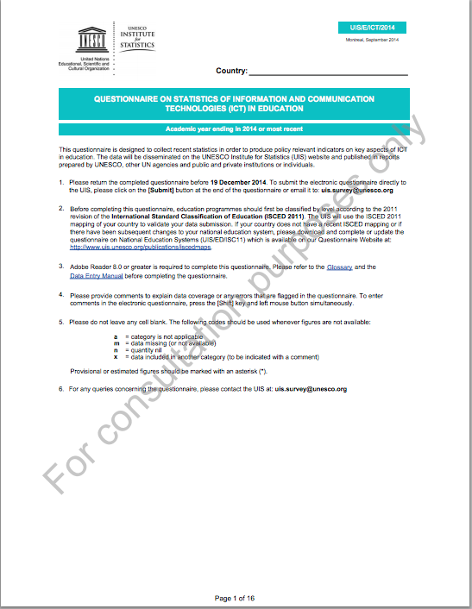
UNESCO UIS indicators survey – infrastructure paper
Defining ICT
Emerging trends
  Digital technology
  Education
Methodology
New indicators
  Visions & strategies
  Environment
  Electricity supply
  Media type
  Access
  Technology model
  Connectivity
  Funding
  Assessment

Slide 18
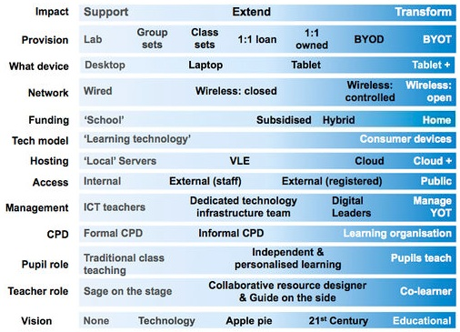
(re)Analysis
Twining’s dimensions of practice
UNESCO UIS’ Existing indicators
http://edfutures.net
Tested against vignettes to consider less favourable infrastructure

Slide 19

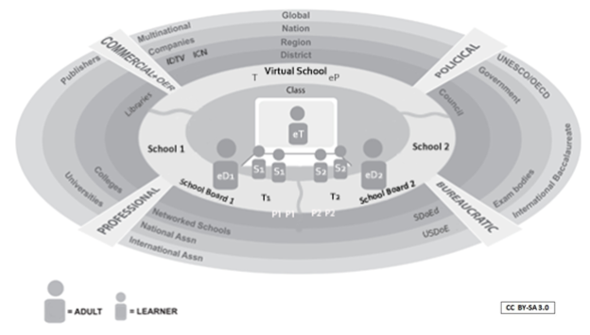











Emerging trends

Slide 20
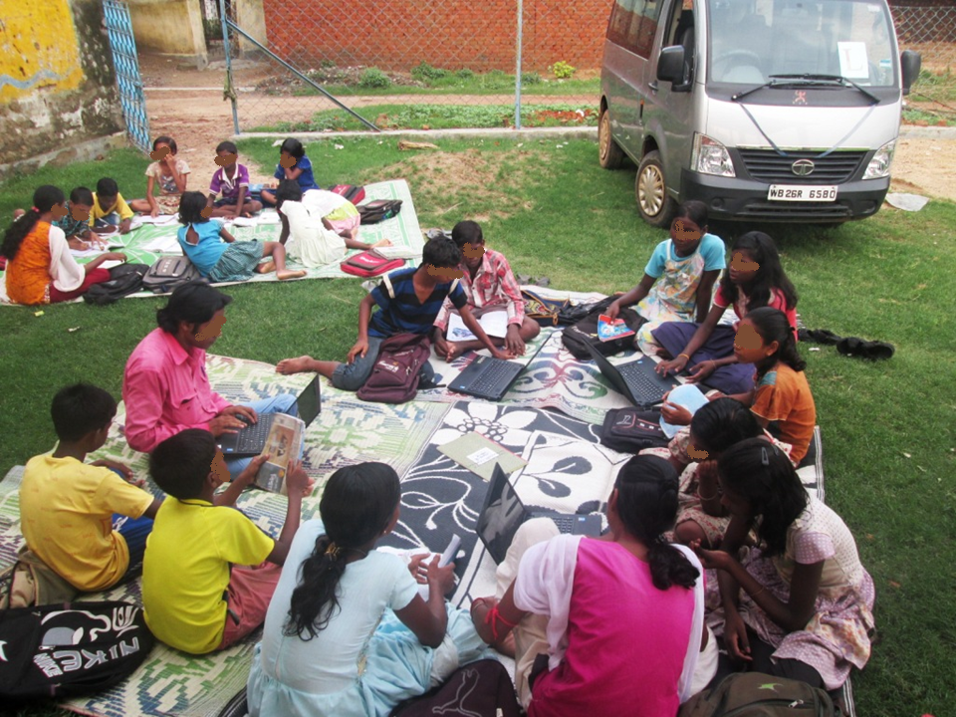
Access
Notes:
Vignette 2 India ITE

Slide 21

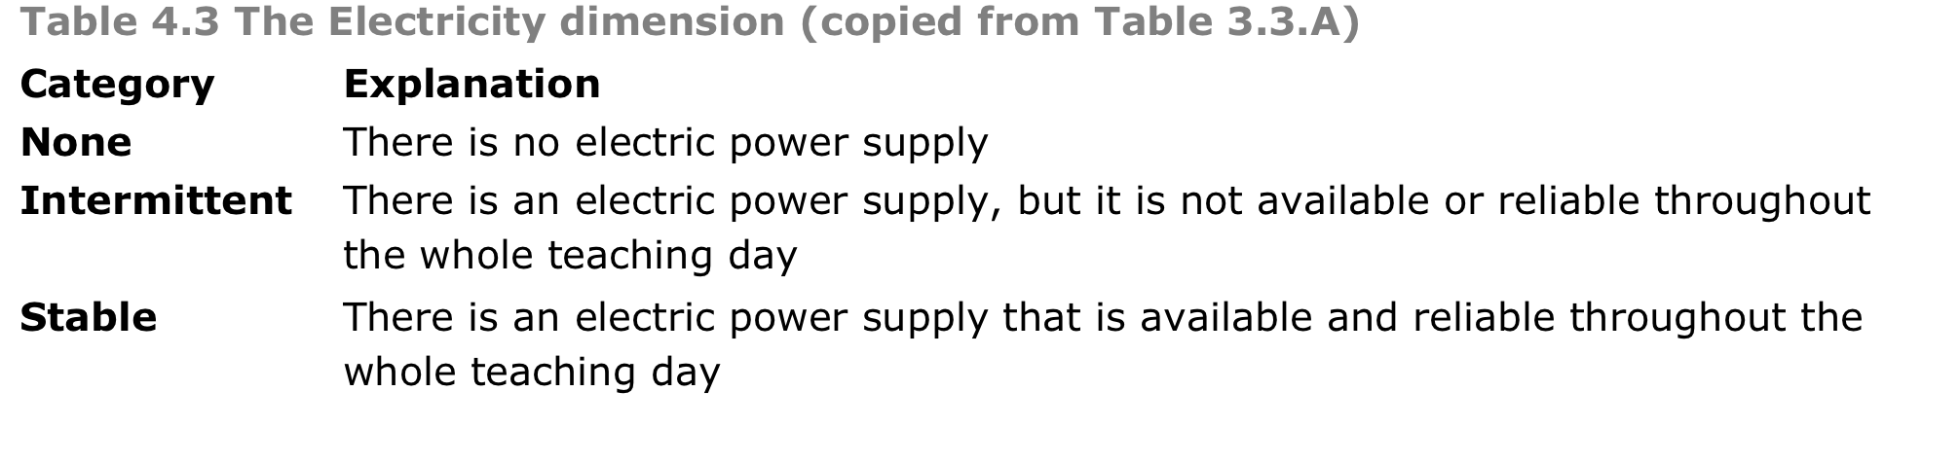
Electricity supply
How power is provided doesn’t matter.
Notes:
Vignette 8 Africa – Samsung
The 12m long space allows for classes of between 20 and 25 students, and each comes equipped with a large 50 inch interactive whiteboard, solar-powered notebooks, tablets and cameras. All devices can connect to the internet via wireless broadband.

Slide 22
Questions & Comments http://www.ifip2015.mii.vu.lt/
Kia ora!
Acknowledgements
Joke Voogt who created the first section of the PPT for presentation at the SITE conference earlier this year.
My UNESCO UIS collaborators, particularly Professor Peter Twining, whose EdFutures research underpins the report and the latter part of this slide show.

